Slide 1
Unified Banking Treasurer Training
Module 1
Overview, Revenue, Expenses,

Slide 2
Welcome
Introduction and Overview
Notes:
Once all participants have joined:
Introduce yourself
Explain
questions are welcome throughout the presentation
you’ll be sharing your screen so they can follow on their screen (then click share my screen and check all the boxes/files. Confirm that everyone can see and hear, click on the PowerPoint and slide 1 should appear
how webinar training works, reiterate that questions are welcome throughout (you may want to have them type their questions using the instant message feature).

Slide 3
Agenda
Time (minutes) | Topic
5 | Introduction and Welcome
5 | Overview of Unified Banking
5 | Role of the Treasurer
20 | Unified Banking Foundations: Logon, Dashboard, Revenues, Deposit slips,
25 | Unified Banking Foundations: Expenses, Purchase Cards, Credit Limits, Cash Advance
Notes:
Explain:
these are the key subjects we plan to cover in this module
Tell them:
if there are other things they want to know about – these can be covered at the end
use the instant messaging to add any questions outside the material covered as they think of them and all will be covered at the end

Slide 4
Overview of Unified Banking

Slide 5
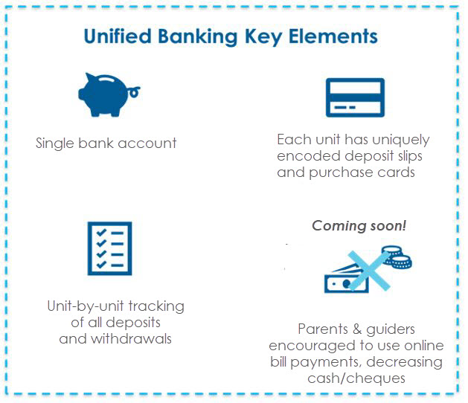


What is Unified Banking Services
Unified Banking Key Elements
Girl Guides of Canada (GGC) is kicking off a simplified process for Guiders to handle money called Unified Banking
Notes:
The image says Province, because we are reusing images from Ontario

Slide 6
What is Unified Banking Services
Unified Banking is part of the National Strategic Priorities as it:
Reduces Administrative Burden
Decrease Financial Management Risks
Increasing Agility for the organization
  Reduces the reliance on volunteer’s own cash by providing purchase cards to each unit
  Uses staff to conduct bank reconciliations, bookkeeping and GST/HST rebates
  Provides access to online, mobile-friendly reports for unit finances (i.e. tracking of deposits, withdrawals and pending transfers to/from districts, areas or provinces)
  Ensures unit bank accounts are closed properly if the unit is permanently closed
  Ensures all Federal and Provincial taxes and rebates are submitted
  Eases the transfer of funds between units, districts, areas and provinces
  Ensures effortless transfer of financial responsibilities when Treasurers change
Notes:
Mobile Friendly does not mean there is an App planned at this time

Slide 7
The Treasurer

Slide 8
Learning Objectives
Learn the essentials of good financial management
Become knowledgeable about Treasurer position requirements
Learn to process transactions in the centralized banking environment
Know how to get support
Know what resources are available to help with banking processes
Notes:
Explain that these are our objectives today
Trainer Note: Key Point: There is a lot to learn but if they learn where to get support and how to find out the answers to their questions, this training will be successful. The centralized banking website is the one place to find out information and more help is being added all the time.

Slide 9
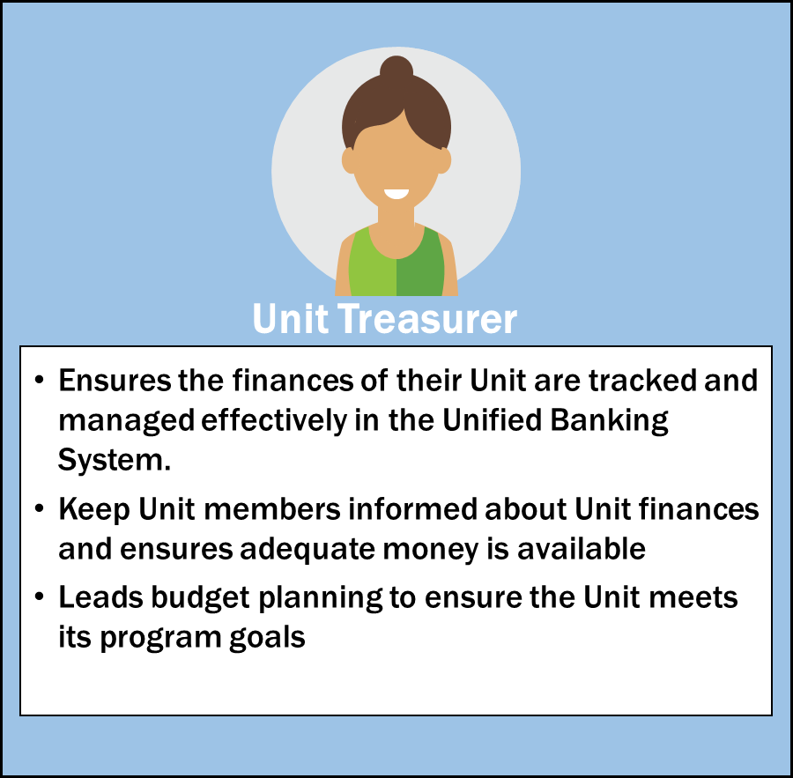
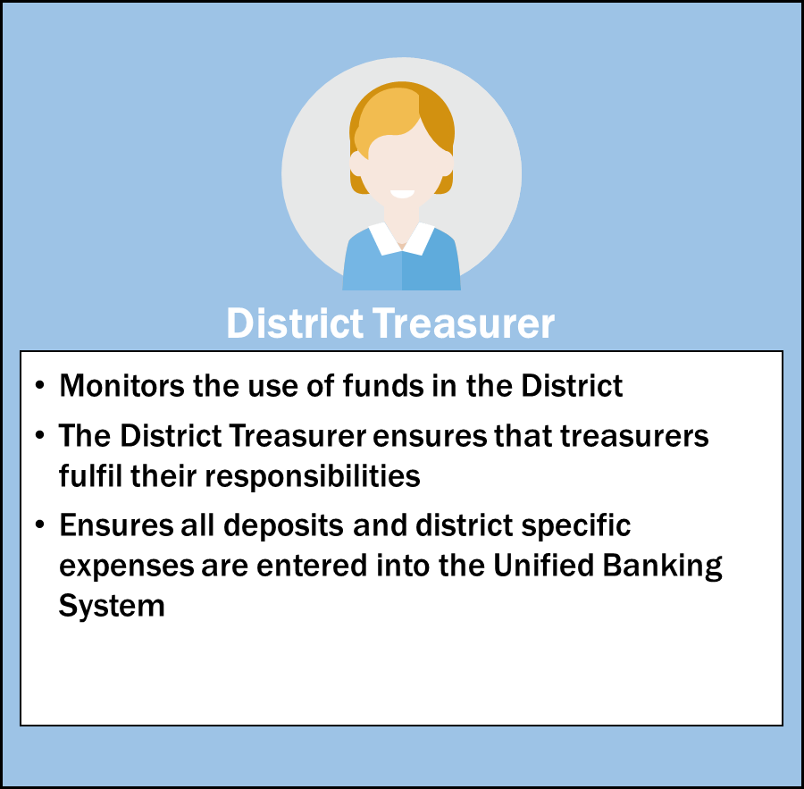
Role of the Treasurer
Notes:
Speaking Points:
Although the roles of a Unit and District Treasurer seem quite different, the roles within the Unified Banking System do not differ significantly. However a District Treasurer may also be responsible for monitoring unit level activity for operational reasons. For this reason we have coined the term Treasurer to represent both Units and Districts
As a Champion it is important to understand the roles and responsibilities of the Treasurer’s, as you will be training them on how their role and responsibilities is impacted by the Unified Banking Program and ensure that they are appropriately executing their job.

Slide 10

Responsibilities of a Treasurer
General Financial Oversight
Monitor the Unit account to
ensure all transactions are
accurate and verified weekly
Support cookie sales and Managing finances
fundraising Deposit all Unit revenues
Ensure the full $60 per case of Verify all deposits and transactions
cookie money is deposited before Prepare manual expense entries for
the payment due date for each non purchase card transactions
campaign Attach receipts for all expenses
incurred
Financial planning and Completing the Year End Reconciliation
budgeting
Plan the Guiding year with the Unit
team including revenue and
expenses

Slide 11
Responsibilities of a Treasurer
All treasurers need to keep their other unit guiders up to date on the finances.
This ensures that nobody is spending money for craft or program supplies that is not available in the unit account. Guiders need to know that they can be reimbursed for these purchases.
All Guiders in the Unit can be given Read-only Access to the account upon request. They will be able to view transactions and run a Balance Report but will not be able to edit or enter any transactions.
Guiders will receive an email with the Read-only Account login and password and can view the Unit Account as above.

Slide 12

Key Actions
  Budgeting
  Revenue and Deposits
  Purchase Card expenditures
  Manual Expenses
  Cash Reimbursement and Advances
  Handling taxes
  Transfers
  Submitting receipts
  Year End Reconciliation
  Reports
  Tools for Treasurers

Slide 13
Budgeting
Treasurers responsibility to lead the process
  All Guiders and girls should be involved
Why Budget?
  Helps to ensure
    there will be money to pay for desired events
    the Unit won’t go into deficit
    the Unit doesn’t end up with too much money
      money earned by girls selling cookies should be spent on those girls
      Money should not be held over for the next guiding year unless there are specific goals
      Trips should have a separate unit account
  Allows for girls to get involved in planning
Notes:
Explain:
Treasurer may be the leader of the financial process, but it involves everyone in the Unit to ensure buy-in and understanding.
Discuss why to bother making a budget
Helps to ensure there will be money to pay for desired events
Helps to ensure the Unit won’t get into deficit
Helps to ensure the Unit doesn’t end up with too much money – money earned by girls selling cookies should be spent on those girls.
Allows for girls to get involved in planning
Discuss planning the Guiding year: not just thinking of activities/places to go
How to pay for them (budget)
What needs to be reserved
Remember: budget is a plan, it can be changed as circumstances change

Slide 14
Accountability for Public Funds
GGC is a charitable organization whose Mission is to be a catalyst for girls empowering girls.
Treasurers are entrusted with the role of ensuring Unit funds are used responsibly in support of our shared mission.
  Funds collected in the name of Girl Guides of Canada–Guides du Canada are considered public funds and must be accounted for in a fiscally responsible manner.
  All monies must be safe-guarded, and all revenues and expenses carefully recorded and documented on a timely basis in the Unified Banking System.
  Unit banking records must be kept up-to-date.
  There is zero tolerance for misappropriation of funds.
  All Guiders in the Unit should be aware of the financial status of the Unit.

Slide 15
Demo - Accessing Unified Banking System
Enter your user ID and password to access the Unified Banking System
Access to your unit account is within Memberzone – you must have an IMIS number
Notes:
Tell them that if they use an incorrect password three times, the account will lock for 10 minutes and then they can try again. If they have forgotten their password, they need to contact their Unified Banking Clerk to have the password reset.
- Show them how to access the Unified Banking System
If a Treasurer does more than one Unit, they get one user ID per unit. They cannot be combined.
Use Google Chrome or Firefox!!! Microsoft Explorer is not always reliable.
At the first login, users are prompted to change their password.

Slide 16
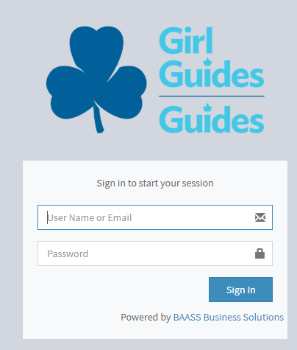
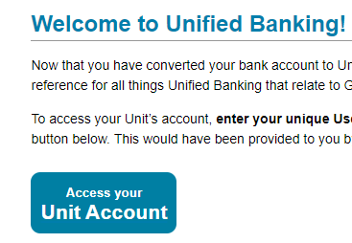
Demo - Log in to Unified Banking
Notes:
Please show demonstration – the slides have included screenshots in case there is any need for going over the presentation via a call or if the Unified Banking System is not yet ready.
Otherwise, this section should just be demonstrated on the Unified Banking System

Slide 17
Demo - Key Components – Dashboard
Expenses
  Waiting Expenses
  Unverified Expenses
  Unverified transfers
  Total Expenses
Revenue
  Waiting Revenue
  Unverified Revenue
  Unverified transfers
  Total Revenue
Notes:
Facilitator Notes:
Show the Treasurer the Dashboard and walk through the following:
Waiting Revenue – Click here to verify deposits made into the account.
Unverified Revenues – Deposits that require more information from your Unified Banking Staff
All Revenues – All Revenues for the Unit/District
Waiting Expenses – Click here to verify expenses made on the Purchase Card.
Unverified Expenses – Expenses that require more information for your Unified Banking Staff and need to be reviewed
All Expenses – All Expenses for the Unit/District.
Introduce verification categories within the system that have been approved by the Guider or Unified Banking Staff:
Waiting Treasurer: needs Treasurer input to allocate (P-Card expenses or deposits, taxes)
Verified, Treasurer: when the Guider has verified the expense in the Unified Banking System and is awaiting the Unified Banking Staff to review and approve the transaction.
Verified, Staff: when the Unified Banking Staff has verified the transaction and the amount is then directly withdrawn from the Unit Bank Account by the Unit Banking Clerk.
Unverified Treasurer: Unified Banking Staff has requested more information. Treasurer to update and/or delete transaction.
Unverified, Staff: The Unified Banking Staff has found something wrong and referred back to the Guider
Unified Banking Staff:
these are individuals who are part of the Unified Banking Team managing the Unit Banking process. There are Unified Banking Staff assigned to each Unit at the national level that deals with the backend processing of the finances involved with Unified Banking

Slide 18
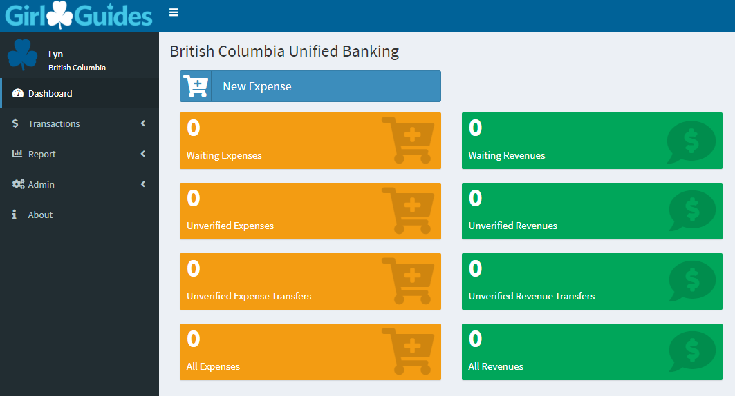
Demo - Dashboard
Notes:
Breaking news (UB-wise) in top white box

Slide 19
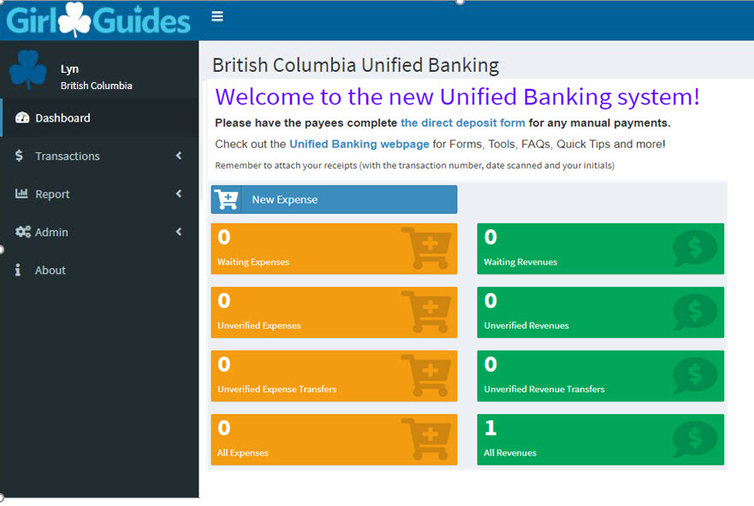
Demo - Dashboard
Notes:
Any news or information that the Unified Banking team wants you to see will show in the banner box above the dashboard items.

Slide 20
Revenues

Slide 21
Revenues
What will show up in my unit’s revenue?
Deposits
  One Deposit slip should be used for all revenue types. Don’t use one deposit slip for cookie money, another for dues etc.
Online Payments (Coming soon)
  Made by parents, Guiders
Transfers
  From other Units
  Unit portion of Registration Fees
All revenue is uploaded automatically. Nothing needs to be input by the treasurer.

Slide 22
Revenues
What do I do with Revenue transactions?
Revenue must be verified and allocated based on the revenue type
Deposit slips must have your Initials, the date and the Transaction ID# written on the front before scanning
Scan, save the file to attach it to the transaction. The file type can be pdf, jpeg, gif, xlsx, docx. The file size limit is 15 MB.
Taxes must be extracted if it is for a taxable activity

Slide 23
Revenues
DO
DON’T
Deposit ALL cash and cheques received promptly
Allocate online payments promptly
  Keep some out for “petty cash”
  Deposit monetary donations for which a charitable receipt is required
  Deposit membership fees paid by cheque or money order.
Note: After the Treasurer completes the Unified banking authorizations form, the Treasurer will be mailed pre-printed deposits slips to be used. Do not share them with another unit as they are unique to your unit.
Notes:
If a donation requires a Tax Receipt it must be sent to National. They will deposit the funds and then allocate the money to the unit. All membership fees should eb sent to National for deposit.

Slide 24
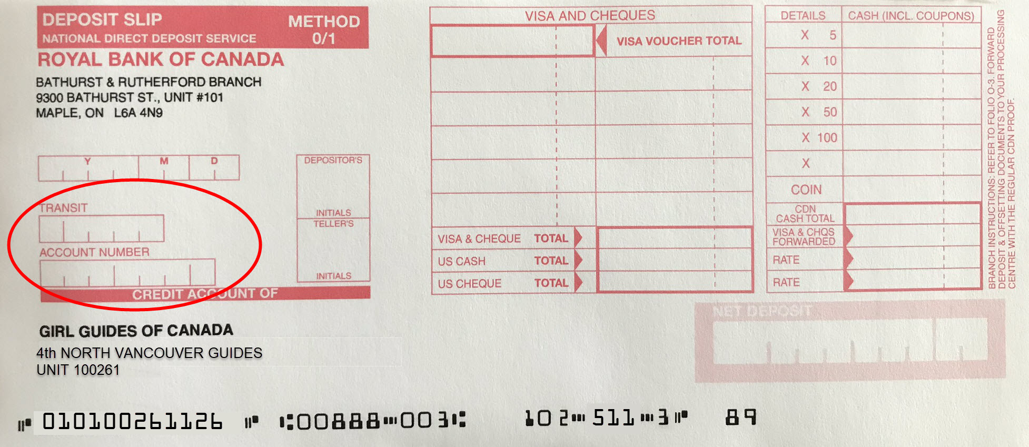
Revenues
Deposit Slips
Leave these two boxes blank. The information is already encoded at the bottom of the deposit slip.
Notes:
Do not enter anything in the ‘Transit’ and ‘Account Number’ boxes. These are already pre- encoded on the bottom of the deposit slip.

Slide 25
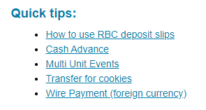
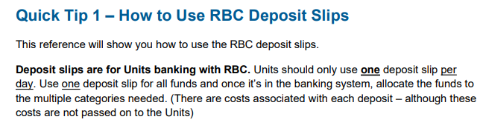
Revenues
Deposit Slips
If you need more help with deposits and deposit slips, check out the Quick Tip on the Unified Banking page in Memberzone
Notes:
Another potential role is : Ensuring that parents confirm the number of cases taken by having them sign for the cases
Not necessarily the role of the treasurer but someone in the unit needs to do it

Slide 26
Revenues
Tracking Cookies
The treasurer should:
    Keep track of girls’ payments received
    Encourage parents to pay for cookies (or camps or events) using online bill payment. (Coming soon)
    Payments made by Parent Bill Payment still need to allocated and verified – however there is no paperwork to be submitted.
Note: A member of the unit should also ensure that parents confirm the number of cookie cases taken by having them sign for the cases. Not keeping track of cookie money is the single most common reason that units get into financial difficulty.
Notes:
Another potential role is : Ensuring that parents confirm the number of cases taken by having them sign for the cases
Not necessarily the role of the treasurer but someone in the unit needs to do it

Slide 27
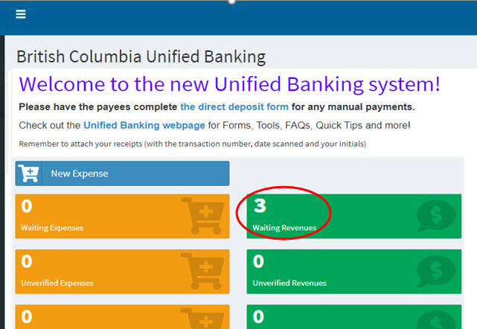
Demo - Allocating Revenue
Waiting Revenues
Notes:
Step 1: Click on Waiting Revenues on the Dashboard.

Slide 28
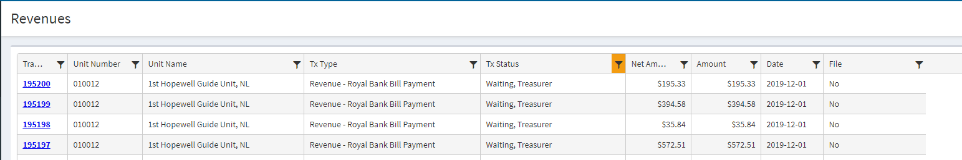
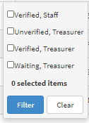
Demo - Allocating Revenue
This is essentially a spreadsheet. You can change the size of the columns by clicking on the edge of the column header to shrink or expand the column.
You can sort or ‘Filter’ the items to find only those you are interested in – by dollar amount, bill payment etc.

Slide 29
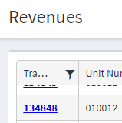
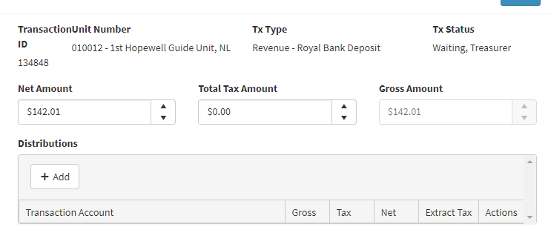
Demo - Allocating Revenue
Waiting Revenues
On the Outstanding Revenues form, click on the transaction number to open up the transaction
Notes:
Step 2: Select the revenue transaction to be allocated

Slide 30
Demo - Allocating Revenue
Waiting Revenues
Notes:
Step 1: Click on Waiting Revenues on the Dashboard.
Step 2: Select the revenue transaction to be allocated
Step 3: Once the transaction is selected you allocate revenue using the Distribution drop down. Click +Add under Distributions and select the distribution the transaction relates to.
Step 4: Once complete, click save.
ENSURE THAT YOU INITIAL, DATE AND ADD THE TRANSACTION ID# BEFORE SCANNING AND ATTACHING YOUR DEPOSIT SLIP

Slide 31
Demo - Revenue Distribution List
Campership subsidies
CWFF collected
Donations
Dues
Equipment Revenues
Fall (Mint) Cookies
Fundraising – Approved
International Trip Revenue
Membership fees collected
Parent orders Revenue (Guide Store)
Previous Year Spring (sandwich) Cookies Revenue
PROVINCE WIDE CAMP Revenues
Special Events (Calendar and Day Camp <15 yrs)
Spring (sandwich) Cookie Revenue
Taxable Activities (extract GST and QST) Overnight and Day 15+ years
Training
Z Finance Clearing Account

Slide 32

Revenues
Things you may encounter – NSF Cheques
If a cheque is returned to GGC as NFS, your Unified Banking Clerk will send you a copy of the cheque
The money will be removed from your account
You must collect the money from the person who wrote the cheque PLUS a service charge of $25
Once deposited:
  Verify and allocate the original amount as usual
  Verify and allocate the additional $25 as “other”, make a note the comments section
  Transfer the $25 to Province, noting the cause and advise your Unified Banking Clerk

Slide 33
Expenses

Slide 34
Expenses
Purchase Cards
All expenses should be made through the P-Cards unless the vendor does not accept Visa
Benefit of P-Cards
  Purchase card holder is not out of pocket
Additional purchase cards (limit 2 per unit)
Notes:
Speaking Points
In some cases if a purchase card cannot be used then a manual expense can be created on the Unified Banking System for reimbursement.
Biggest challenge most Treasurers have is getting purchase card holder to give in the receipts promptly.
Keep purchase card holder informed about account balance so she doesn’t overspend.
Account is cleared monthly, and credit limit resets then
Facilitator Notes
Find out whether any of them have Units with more than one card; If so:
Credit limit for two cards is $150 for each card (i.e. ½ of $300)
A credit limit increase will not be for both cards, only for the one the increase is requested on

Slide 35
Expenses
Demo – Allocating a P-Card expense
Allocate the waiting expense
Notes:
Step 1: Select Waiting Expenses on the Dashboard
Step 2: After selecting Waiting Expenses, you are directed to the outstanding expenses page where you select the transaction to be allocated.
Step 3: Once the transaction is selected, you are prompted to the Transaction page where you select the distribution to allocate the expense to. Click the +Add button to select the distribution in the drop down.
Step 4: Attach your receipt by clicking select files
Step 5: Click save.
ENSURE THAT YOU INITIAL, DATE AND ADD THE TRANSACTION ID# BEFORE SCANNING AND ATTACHING!

Slide 36
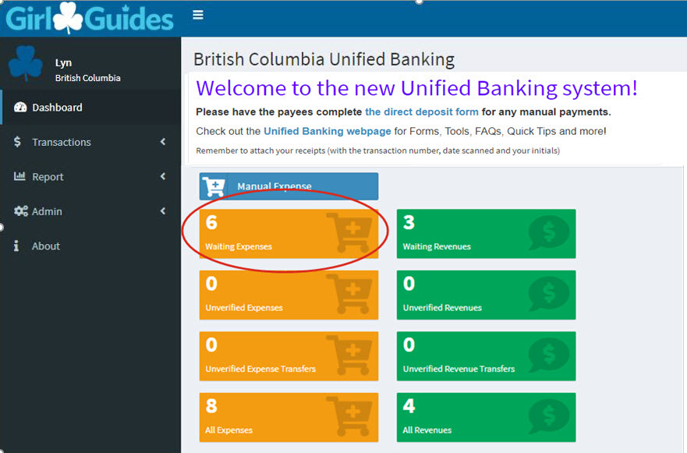
Demo – Allocating a P-Card expense
Waiting Expenses
Notes:
Step 1: Select Waiting Expenses on the Dashboard

Slide 37
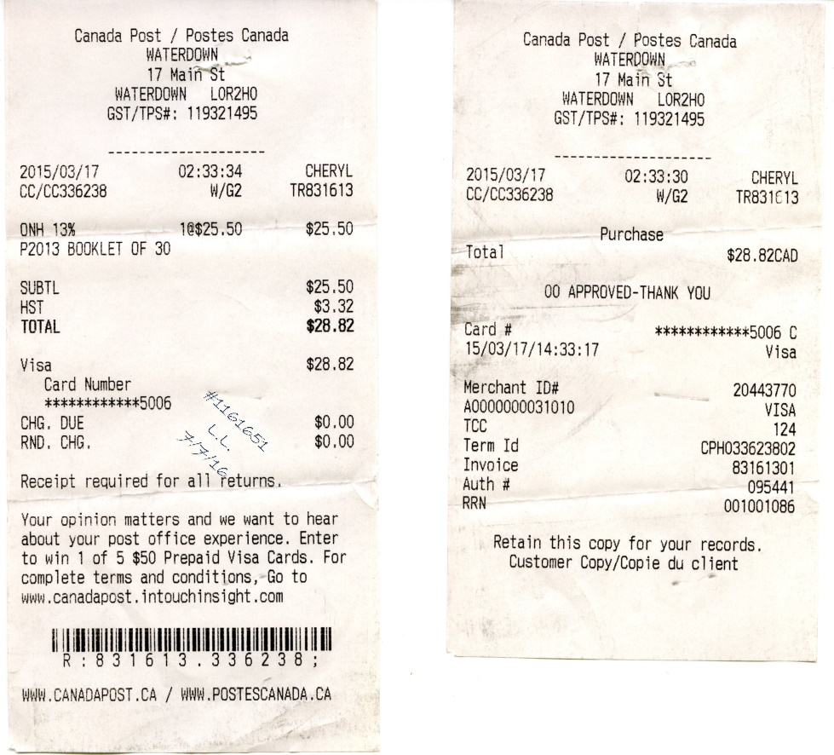
Demo – Allocating a
P-Card expense
Use the merchant receipt with the tax breakout, not the summary credit card receipt
First thing to do: break out taxes, if any
Choose verification code(s)
Put transaction number, date and your initials on front of receipt
Scan receipts and attach the file
Notes:
Demonstrate how to split out taxes BEFORE allocating
Use the cash register receipt, not the summary credit card – only the cash register receipt shows the taxes as well as what was bought
Review spending guidelines.

Slide 38
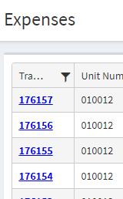
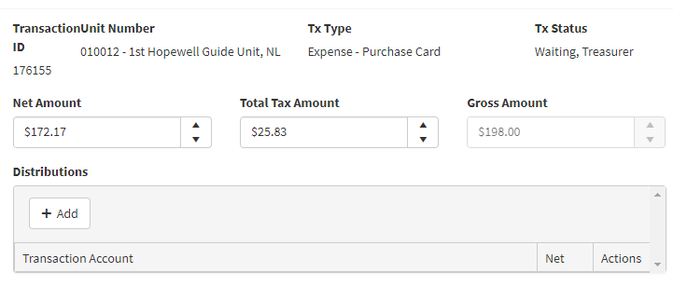
Demo – Allocating a P-Card expense
Waiting Expenses
On the Outstanding Expenses form, click on the transaction number to open up the expense transaction form
Notes:
Step 2: After selecting Waiting Expenses, you are directed to the outstanding expenses page where you select the transaction to be allocated.

Slide 39
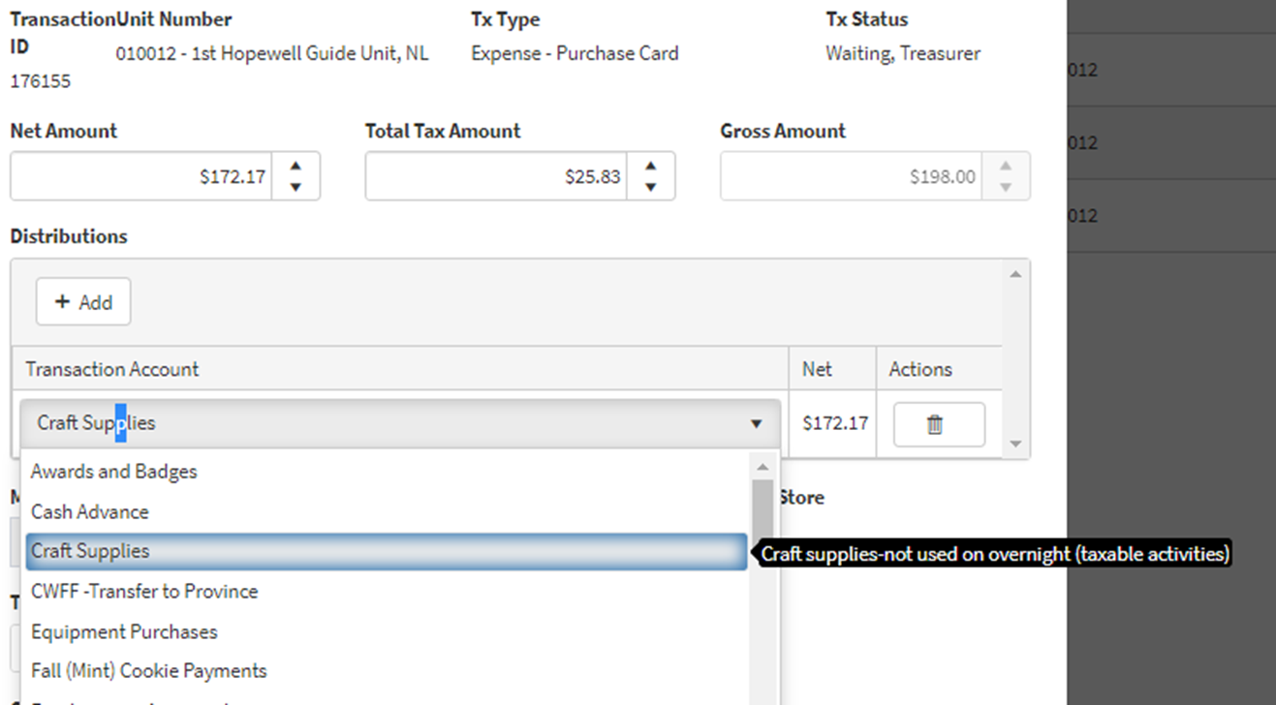
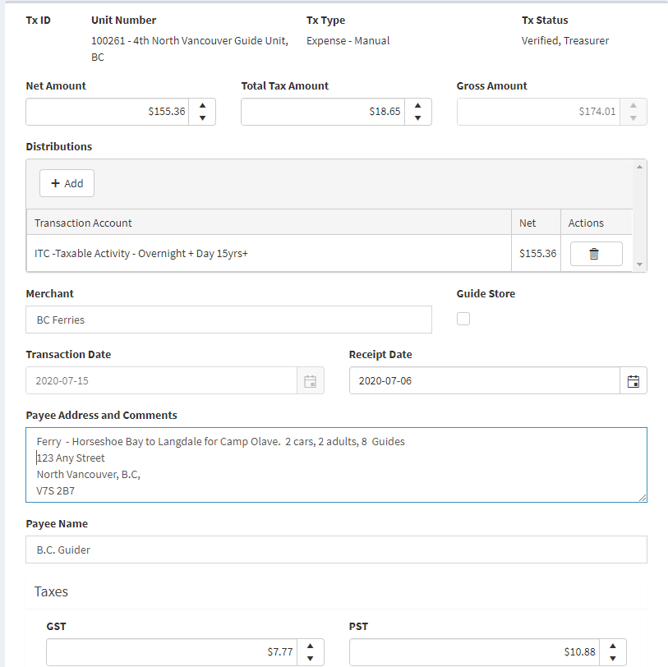
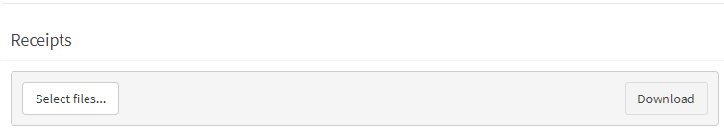
Demo – Allocating a P-Card expense - top section
Waiting Expenses
Notes:
Step 3: Once the transaction is selected, you are prompted to the Transaction page where you select the distribution to allocate the expense to. Click the +Add button to select the distribution in the drop down.

Slide 40
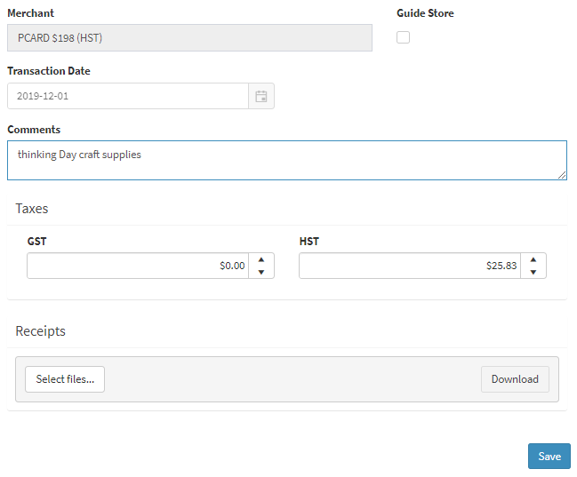
Demo – Allocating a P-Card expense - middle section
Waiting Expenses

Slide 41

Demo – Allocating a P-Card expense
Waiting Expenses
Notes:
Step 4: Ensure you have added your Initials, the Date and Transaction ID# to the front of the receipt before you scanned.
Step 5: Attach your receipt by clicking select files. The file type can be jpeg, gif, xlsx, docx. The file size limit is 15 MB.

Slide 42
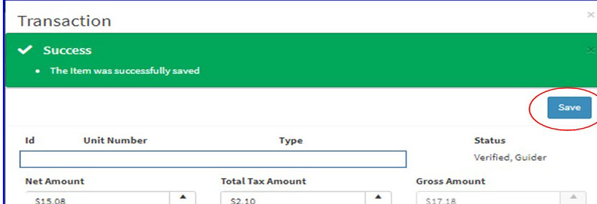
Demo – Allocating a P-Card expense
Waiting Expenses – Saved
Notes:
Step 5: Click save.

Slide 43
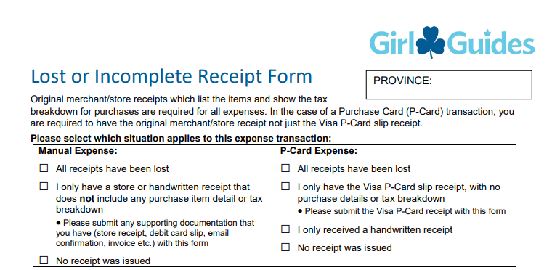
Demo – Lost or Incomplete Receipt form
If you have lost a receipt or the guider didn’t give you one, you need to complete the Lost or Incomplete Receipt form.
This also applies if the only receipt you have is a total, not a breakdown of the items and taxes, if applicable.
This form can be found on the Unified Banking website in Memberzone.
The form requires the signature of two guiders.
Notes:
Step 5: Click save.

Slide 44
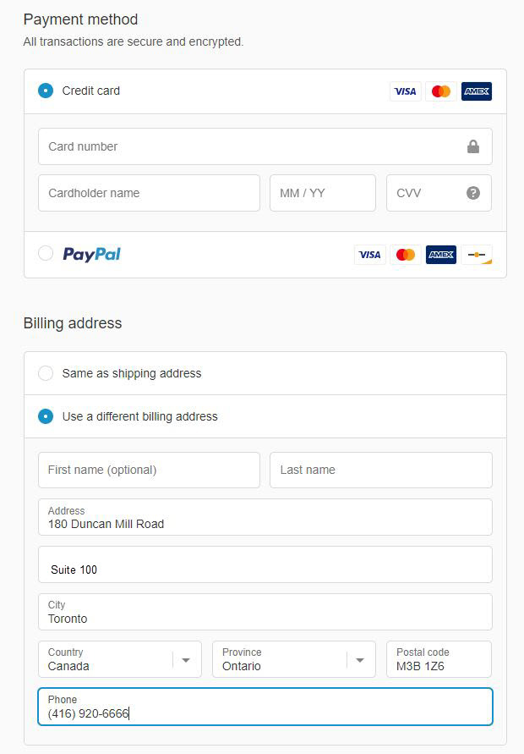
Expenses
Using the purchase card on-line
Billing Address is
    180 Duncan Mill Rd, Suite 100, Toronto ON M3B 1Z6
    Phone number is 416-920-6666
Shipping Address is yours
For Guide Store purchases, DO NOT click on PayPal
Notes:
If the Guider has a personal PayPal account, ensure that they check the defaults when they are checking out. They need to make sure that they are indicating they are paying by credit card, not using a PayPal account. If they make an error in the Billing address, they will need to call the Guide Store to have their card unlocked. There is no indication the card is locked, and it only takes one wrong try (not three) for this to happen. However if their payment is rejected, this is most likely the cause, unless they do not have enough credit on the card. The system will remember their card information and they do not have to enter it again the next time they make a purchase.

Slide 45
Expenses - Purchase Card
Purchase Card Credit Limit
Default credit limit is $300
Two types of increase:
  Permanent increase - only until the end of guiding year
  Temporary increase - based on individual request for a specific purpose
Do not use the P-Card if there are insufficient funds in the Unit account to cover the charge.
Notes:
Speaking Points
It is best practice that the amount to be used on the P-Card should only be used if there are sufficient funds in the bank account to cover them. For example if there is $100 in the bank account, but $150 on the purchase card only $100 can be used to make a purchase.
It takes a couple of days for a credit limit increase to go through. Increases won’t be approved unless there are sufficient funds in the account.
Based on the transactions incurred there are instances where the credit limit must be increased based on the unit/districts needs. This may be permanently i.e.. based on the size of the unit, if it’s a large unit it will require a higher limit. Temporarily if there is a need due to a camping activity that is coming up.

Slide 46
Expenses - Purchase Card
Purchase Card Credit Limit
The card will be rejected if the transaction will put you over your credit limit.
The card balance is paid once a month by GGC. Keep track of what you have spent, especially if it is getting close to the end of the month.
Remember that this is a Visa card and works just like your own card
  If you have money in the bank but no credit left on the card – you can’t use it until the balance on the card is paid.
  If you have no money in the bank, but have a credit balance on the card – DON’T use it. Paying off the card balance will put your unit account in deficit and may result in your card being suspended.

Slide 47
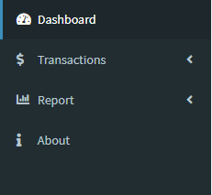
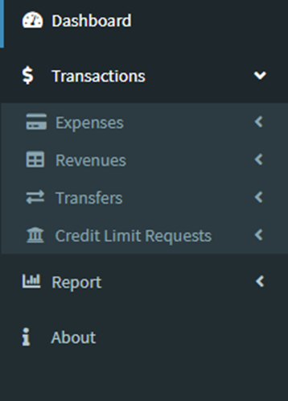
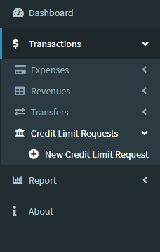
Expenses - Purchase Card
Purchase Card Credit Limit increase

Slide 48
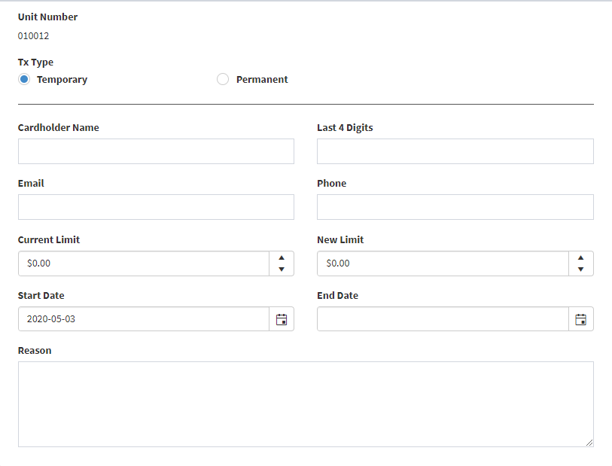
Expenses
Purchase Card
Credit Limit increase
Notes:
Step 1: Select the Credit Limit Request from the left pane and populate the type of request, cardholder name, last 4 digits of the P-Card, email of the cardholder , phone number of the cardholder, current limit, new limit, the start and end dates of the new credit limit, and the reason for the request.
Step 2: Save the request. It will be automatically sent to Unified Banking Staff for verification. The Treasurer and cardholder will receive email confirmation when approved.

Slide 49
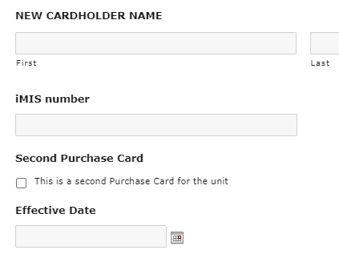
Expenses -
Purchase Card
Additional Cards
Order using Unified Banking Authorization Form found on the Unified Banking site in Memberzone
Cost $15/year
Each pcard will have credit limit of $150
Requested Pcard increases will ONLY apply to the card requested, not both
There is a box at the bottom of the form indicating this is a request for a second card

Slide 50
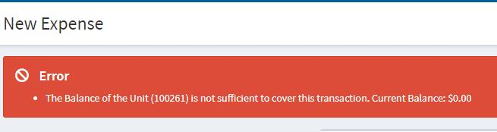
Expenses
Manual Expense
These are reimbursements for money which has been paid out by a guider
Types:
  Non P-Card expenses to be reimbursed
  Parent refunds
  Vendor payments
Payments are processed weekly.
  EFT payments are paid regardless of the amount
The Unified banking system cannot accept a manual expense greater than the balance in the account. You will receive an error message if you try.
Notes:
Speaking Points
Review what sorts of things might result in manual expense:
Non card holder making purchase on behalf of Unit
Program item where vendor doesn’t take the card (eg Bubbles the Clown comes to the Unit to do magic tricks at Unit party)
Payment to an outside camp where you already have received the bill and they don’t take card
Individual expenses submitted for less than $20 will only be paid once a year, at the end of the guiding year which is August 31.
Guiders can sign up for Direct Deposit/EFT . Expenses are paid regardless of the amount.
Use the ongoing $50 Cash Advance to have cash on hand to pay small expenses
Accumulate expenses until they reach $20

Slide 51
Expenses
Manual Expense – Reimbursement Methods
Reimbursement by EFT (Direct Deposit) is encouraged
  Guiders, Parents, vendors can all enroll
  Paid regardless of the amount
Reimbursement by cheque
  Default method if Direct Deposit is not set up
  Can be requested to pay vendors who don’t take Visa
  Individual expenses submitted for less than $20 will only be paid once a year, at the end of the guiding year
  Guiders should accumulate small expenses and submit them in total once they reach $20.
Notes:
Speaking Points
Review what sorts of things might result in manual expense:
Non card holder making purchase on behalf of Unit
Program item where vendor doesn’t take the card (eg Bubbles the Clown comes to the Unit to do magic tricks at Unit party)
Payment to an outside camp where you already have received the bill and they don’t take card
Individual expenses submitted for less than $20 will only be paid once a year, at the end of the guiding year which is August 31.
Guiders can sign up for Direct Deposit/EFT . Expenses are paid regardless of the amount.
Use the ongoing $50 Cash Advance to have cash on hand to pay small expenses
Accumulate expenses until they reach $20

Slide 52
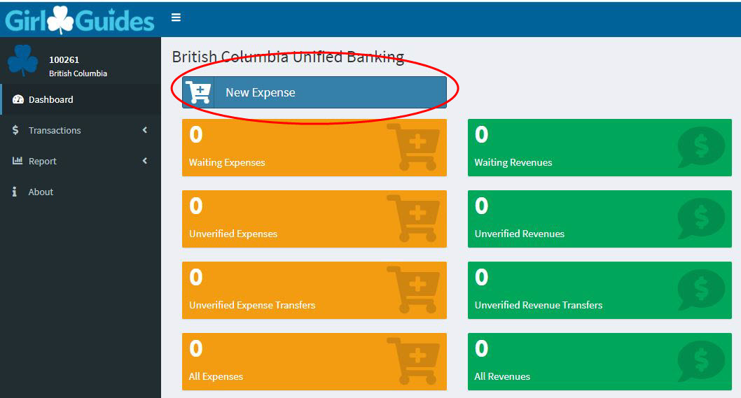
Demo - Manual Expense
Notes:
Step 1: On the dashboard, select New Manual Expense.

Slide 53
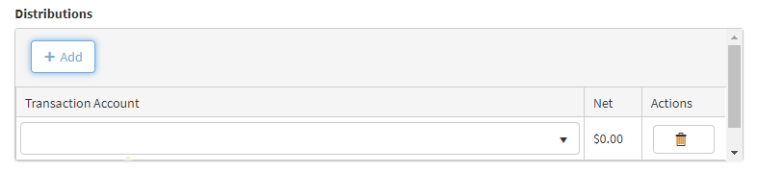
Creating a new Manual Expense
1.
The Net amount is entered first – the amount before taxes. The Gross amount is automatically calculated.
2.
Click on the +Add button to determine the type of expense. If the amount is made up of different types, e.g. dues and craft supplies, click to add a second type. You can use the garbage icon to delete the transaction type if it is wrong.

Slide 54
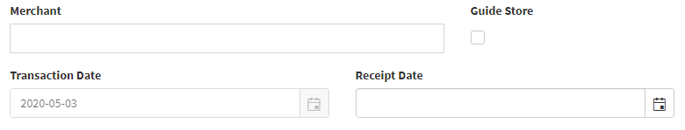
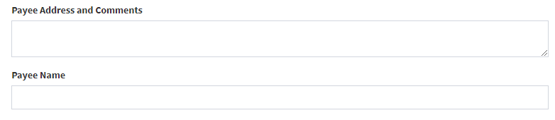
Creating a new Manual Expense
3.
Enter the name of the merchant and the date of the receipt. The Transaction date is auto populated with the current date.
4.
Enter the payee name and full mailing address. This is required even if they have EFT/Direct Deposit.

Slide 55
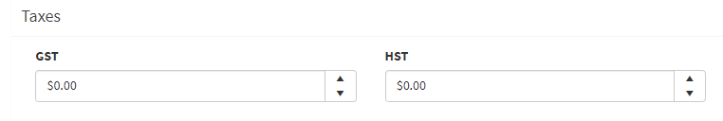
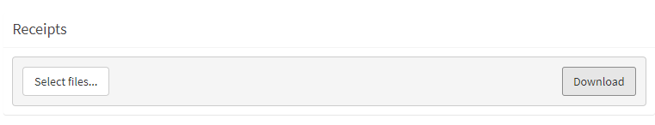
Creating a new Manual Expense
5.
The taxes will be automatically calculated for you. These are calculated according to the province you live in, and may be GST, PST and/or HST. SAVE the transaction to get a Transaction number
6.
Write the transaction number, the date and your initials on the receipt where it is clearly visible, then scan or take a picture of it. Select the image files on your computer for the receipts and attach them. Click the Save button to attach the receipt.

Slide 56
Demo - Expenses Distribution list
Awards and Badges
Cash Advance
Craft Supplies
CWFF Transfer to Province
Equipment purchases
Fall (Mint) Cookies
Fundraising – Approved
GGC property rental
Gifts
International Trip Purchases
ITC overnight+day 15 +
ITC No tax charged overnight+day 15 +
Membership fees forwarded
Parent orders purchases (Guide Store)
Postage / Courier
Previous Year Spring (sandwich) Cookies Expense
Printing Office Supplies and NSF fee
Program (non Craft Supplies)
PROVINCE WIDE CAMP payments
Public Relations
Special Events (Calendar + Day Camp <15 yrs)
Spring (sandwich) Cookie Payments
Training
Travel (Mileage) non trip related
Z Finance Clearing Account

Slide 57
Expenses
Manual Expense – Cash Advance
Special one-time payment
  For example: a camp where they only take cash
Ongoing to pay for out of pocket expenses (like Petty Cash)
  Can be topped up through the year and closed at year-end

Slide 58
Expenses
Manual Expense – Cash Advance
There are two types of Cash Advances
1. Ongoing Advance: Requested by the Treasurer to purchase small items when the purchase card cannot be used (e.g. at the dollar store) or to reimburse other Guiders in the unit for small dollar amounts of out of-pocket expenses, a unit’s “petty cash”. An ongoing advance is usually $50.00. To request a different amount, contact your Unified Banking Clerk.
2. One-time Event Advance: Used to pay for an event where the cost is not certain until the date of the event or in situations where only cash is accepted. The amount would be the estimated cost.

Slide 59
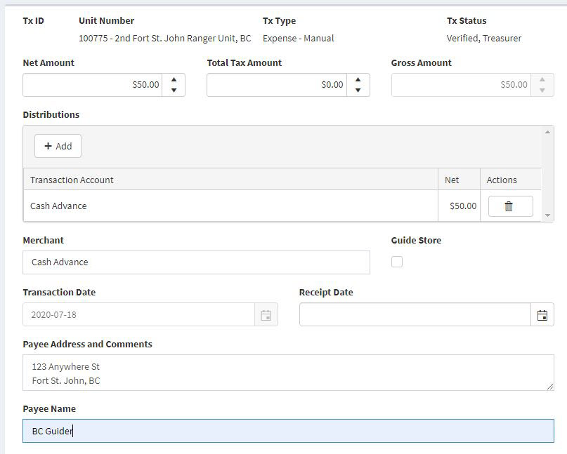
Expenses
Manual Expense – Cash Advance
  Step 1.
  Create a New (Manual) Expense for $50; use the “Cash Advance” allocation and input Cash Advance for the Merchant and select the current date for the receipt date. Input the Guider’s information in the Payee Address and Comments section as well as their name in the Payee Name section.

Slide 60
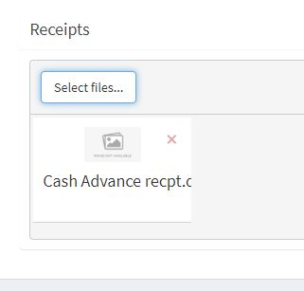
Expenses
Manual Expense – Cash Advance
  Step 2.
  Complete the Cash Advance request form and attach it as a “Receipt” to the Manual transaction.

Slide 61
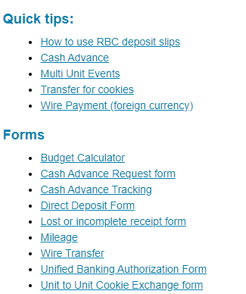
Expenses
Manual Expense – Cash Advance
  Full instructions for both the Ongoing Cash Advance and the One Time Event cash Advance can be found on the Unified Banking website in Memberzone.
  This is also where you will find the Cash Advance Request Form and the Cash Advance Tracking form.

Slide 62

Things you may encounter
For both Revenues and Expenses, you might see a transaction under ‘Unverified Expense’ or Unverified Revenue.
This can happen when you submit a transaction that is missing information or requires more details.
Your Unified Banking Clerk will ‘unverify’ the transaction and send you an email advising you that you need to fix this item.

Slide 63
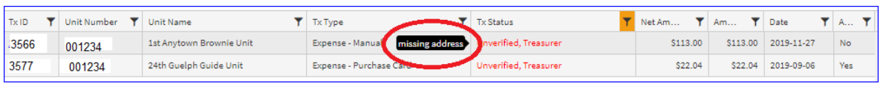
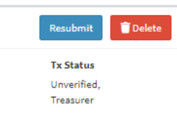
Things you may encounter
  Click on the item to be verified.
  A message appears when you hover over the status and you will see the comment of entered by the Unified Banking Clerk with the reason it was unverified and what is required to fix it.
  In this example it is missing the address of the payee.
  Fix the entry then click on the Resubmit button

Slide 64
Questions ?

